Slide 1
ReCell – Dynamic Pricing Strategy using Machine Learning
-Rochita Sundar, Postgraduate Student
Data Science and Business Analytics, University of Texas at Austin

Slide 2
Background
A new IDC (International Data Corporation) forecast predicts that the used phone market would be worth $52.7bn by 2023 with a compound annual growth rate (CAGR) of 13.6% from 2018 to 2023
Used devices continue to provide cost-effective alternatives to both consumers and businesses that are looking to save and are sold at attractive offers through third-party vendors/platforms, such as Verizon, Amazon, etc. They can be sold with warranties, can also be insured with proof of purchase, as well the second hand trade reduces environmental impact and helps in recycling and reducing waste
ReCell, a start-up aiming to tap the potential in this market, wants to analyse the data provided, build a linear regression model to predict the price of a used phone and identify factors that significantly influence it such as-
Data Overview
brand_name: Name of manufacturing brand
os: OS on which the phone runs
screen_size: Size of the screen in cm
4g: Whether 4G is available or not
5g: Whether 5G is available or not
main_camera_mp: Resolution of the rear camera in megapixels
selfie_camera_mp: Resolution of the front camera in megapixels
int_memory: Amount of internal memory (ROM) in GB
ram: Amount of RAM in GB
battery: Energy capacity of the phone battery in mAh
weight: Weight of the phone in grams
release_year: Year when the phone model was released
days_used: Number of days the used/refurbished phone has been used
new_price: Price of a new phone of the same model in euros used_price: Price of the used/refurbished phone in euros

Slide 3
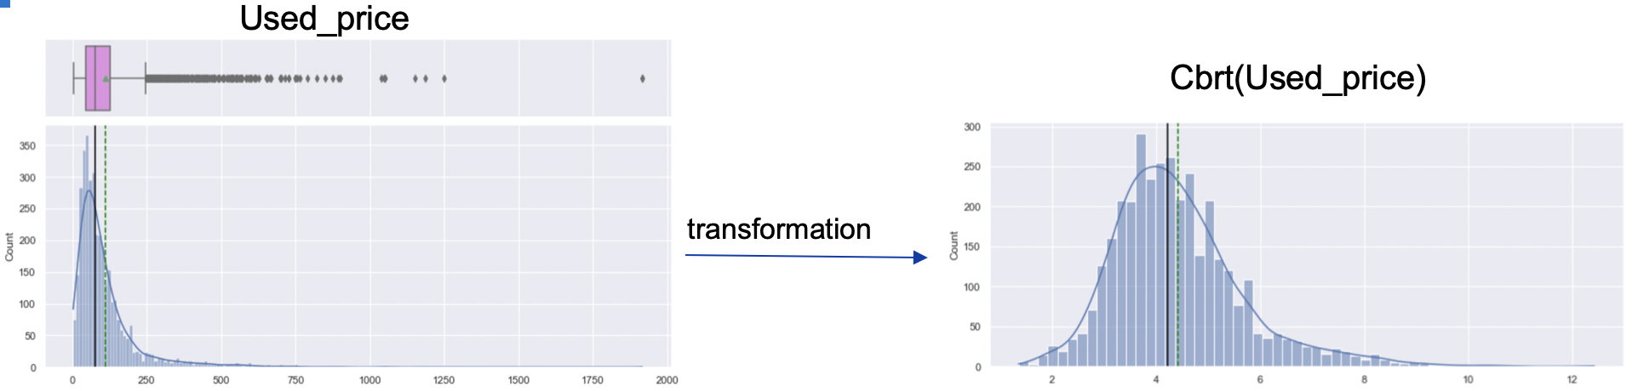
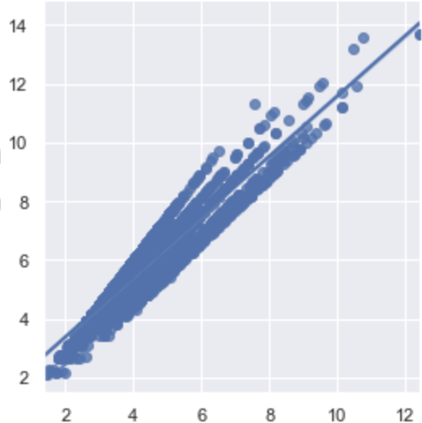
Data processing for modelling
The mean used_price is approx. €110 while the the mean new_price is approx. €237 (2.15 times mean used_price)
The data is heavily skewed right, indicating several phones have both high used_price and new_price
Model was built with no transformation, sqrt, cbrt and log transformations and evaluated. Cbrt was found to be best for the problem at hand
The cbrt plot of used_price and new_price appears to follow a normal distribution, and data is much easier to visualize and interpret
The linear correlation between the transformed columns - cbrt(used_price) and cbrt(new_price) is same as before transformation; strongly positively correlated with correlation factor 0.93
Cbrt(New_price)
Cbrt(Used_price)

Slide 4
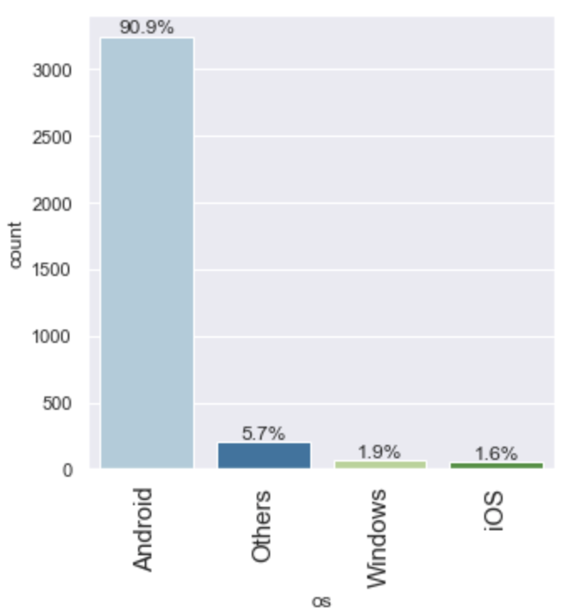
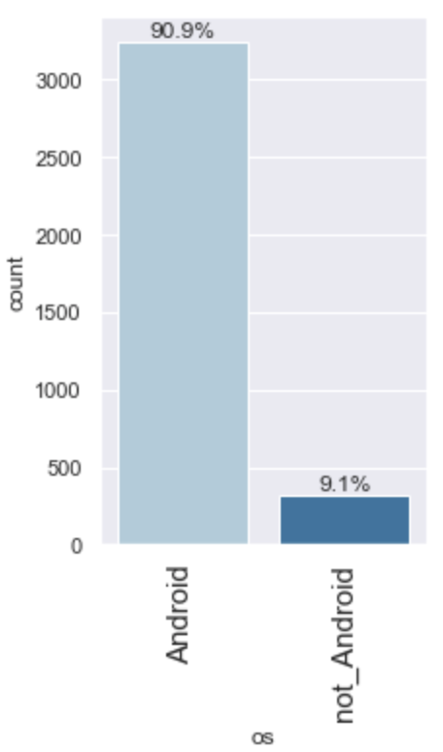
Data processing
More than 90% of the used phone market is dominated by android devices.
iOS, Windows and Others – grouped
together as not_Android for modelling
transformation
34 manufacturing brands were split into 3 buckets based on the average price of a new phone by that manufacturing brand, such that distribution was not skewed in either bucket
1211 phones
High range
(>€250)
1297 phones
Mid range
(€150 to <€250)
1063 phones
Low range
(<€150)
transformation
34 manufacturing brands

Slide 5
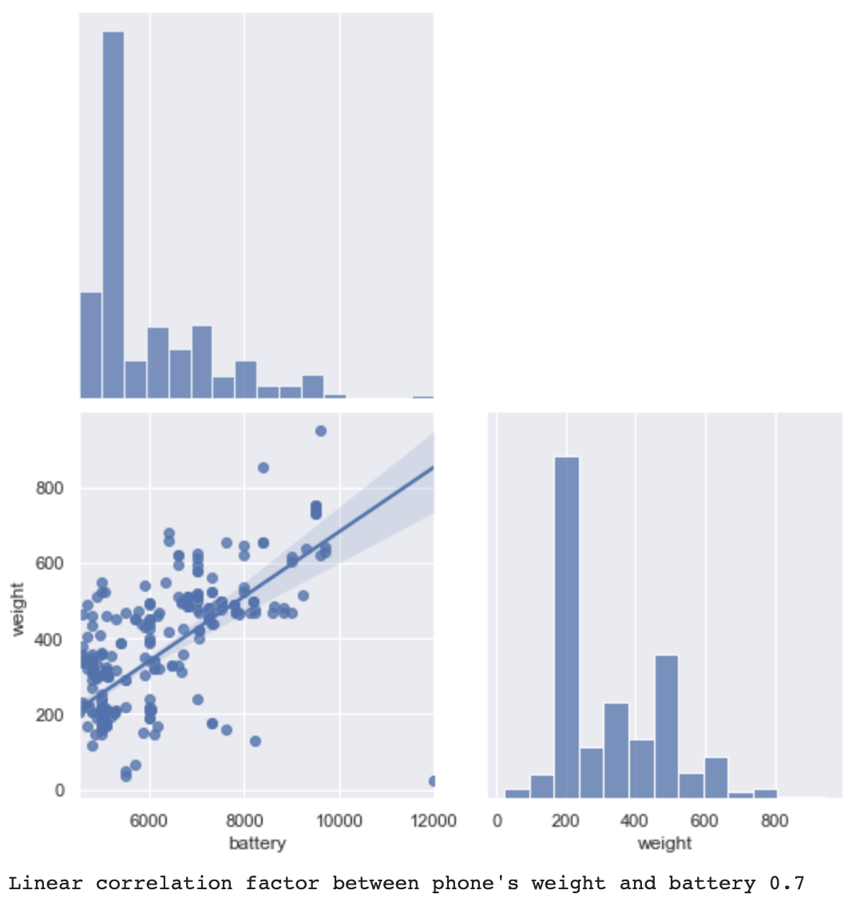
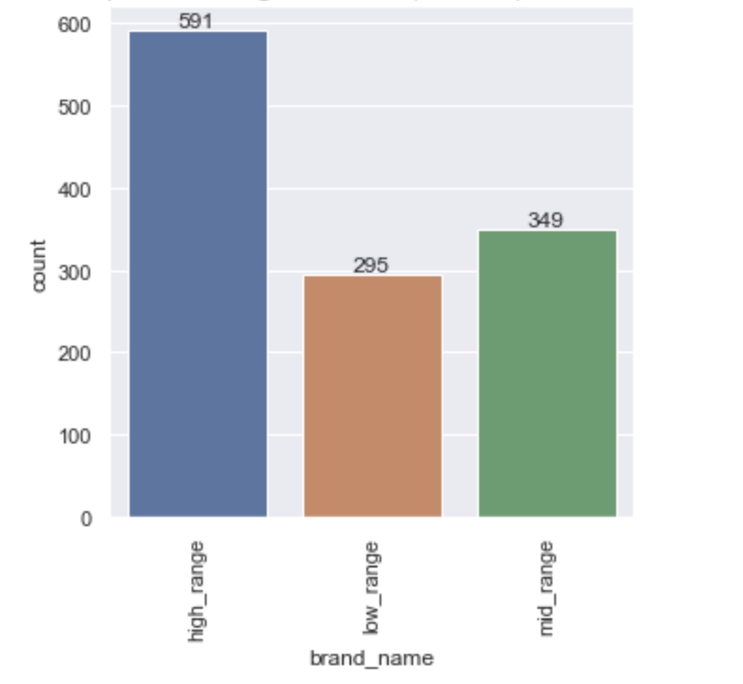
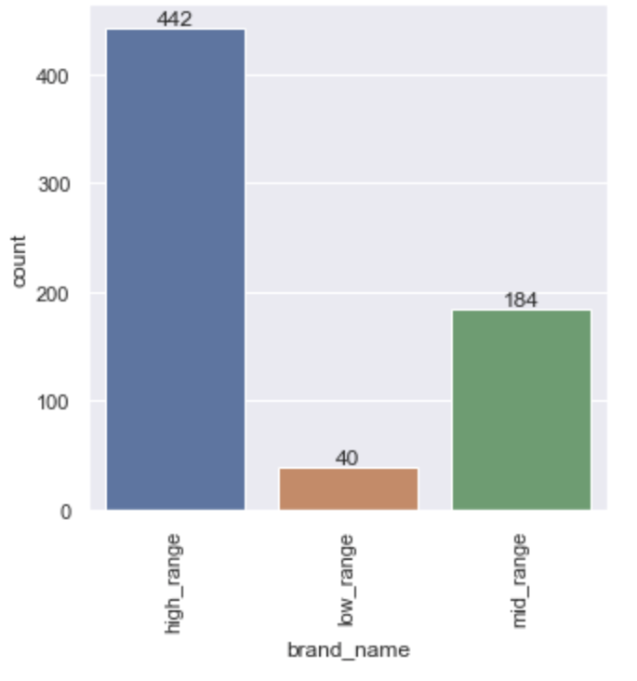
Exploratory Data Analysis
A moderate correlation was observed between a phone's weight and battery for phones with large batteries drawing the conclusion that as the battery size increases, so does the weight
High_range brands (i.e., comparatively expensive) offer the maximum number of refurbished phones with great selfie_camera and large screen_size followed by mid_range brands and then low_range brands (i.e., comparatively cheaper)
No. of refurbished phones with large screen_size (>6 inches)
No. of refurbished phones with great selfie_camera (>8MP)

Slide 6
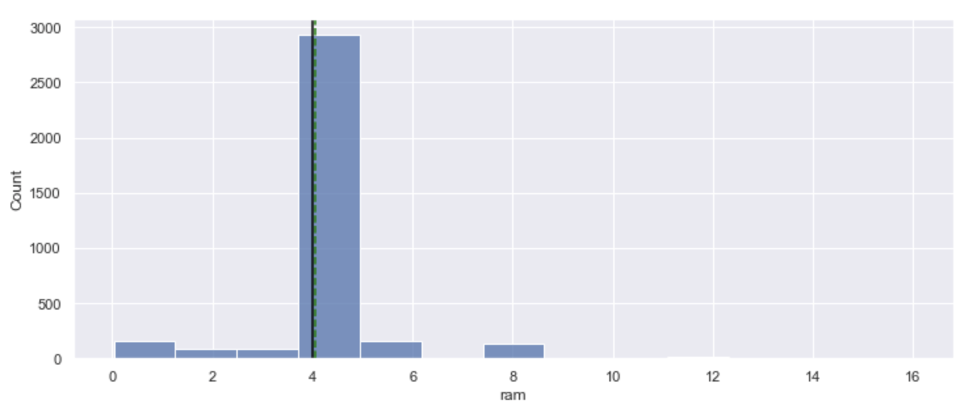
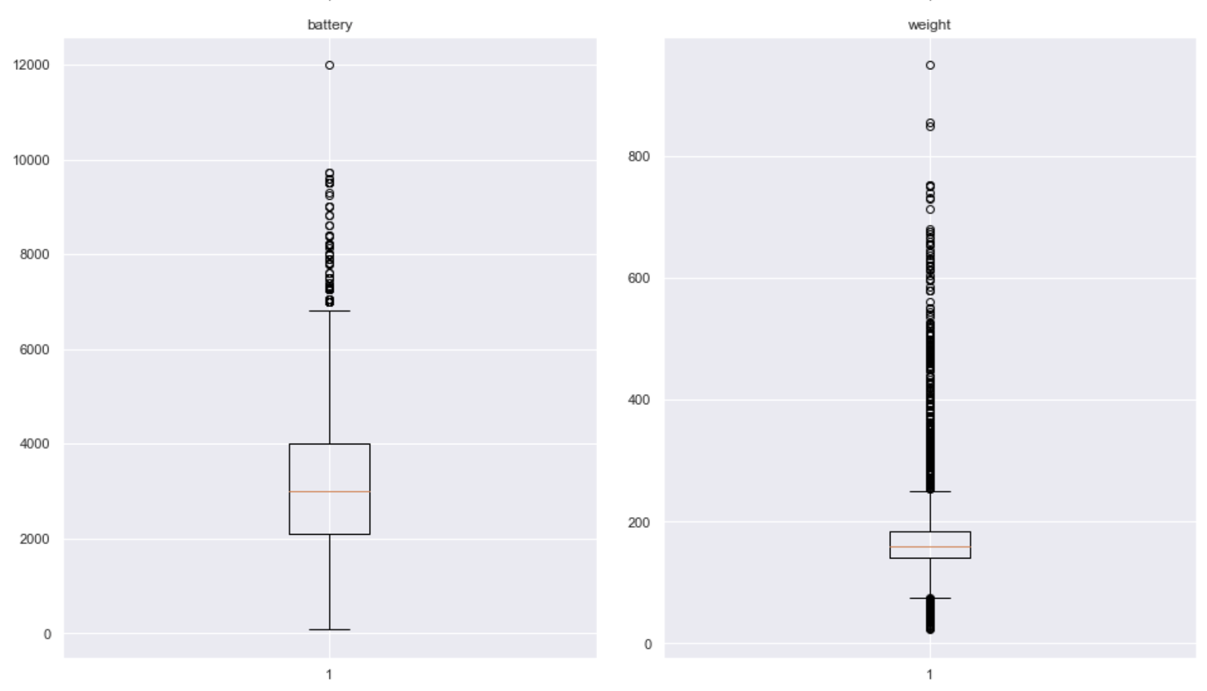
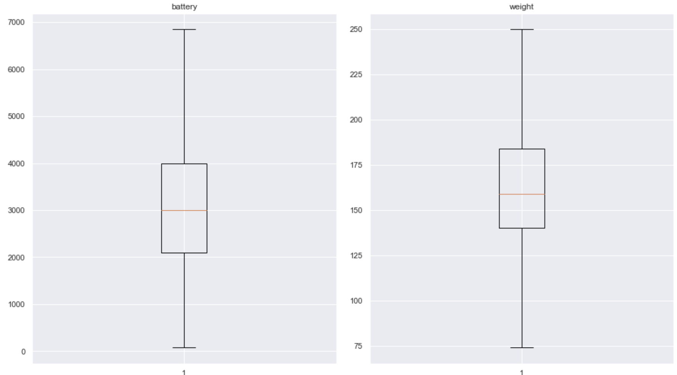
Data processing
Majority of phones provide a RAM of 4GB with negligible upper and lower outliers. Hence, this was dropped out of consideration while building the model
All numeric columns were further treated for missing values (filled with median value of the column of respective manufacturing brands) as well as for outliers (flooring and capping – Q1-1.5*IQR to Q3+1.5*IQR)
transformation
(missing value &
outlier treatment)
on weight and battery

Slide 7
Data overview
cbrt(used_price) is negatively correlated with number of days_used (-0.55)
cbrt(used_price) is strongly-positively correlated with cbrt(new_price) (0.93)
cbrt(used_price) is positively correlated with selfie_camera (0.64), main_camera (0.52), screen_size (0.54), battery ( 0.52)

Slide 8
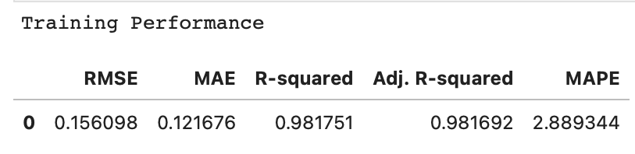
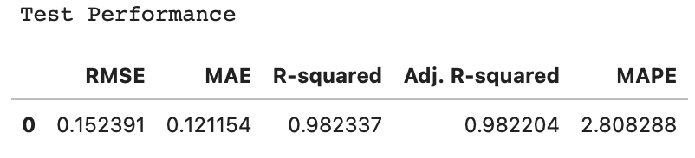
Model Performance Summary
The data was split into 70:30 as the train set and test set. A linear regression model was build using sklearn and statsmodel using the train data set and the performance of the model was evaluated using the test data set. The assumptions of linear regression (no multicollinearity, residuals vs. fitted plots, normality of residuals, homoscedasticity) were checked and in the process the model was retrained and refined dropping insignificant predictors or after further transforming the predictors
Cbrt(Used_price) = 1.0954 + 0.0030*(screen_size) + 0.0055*(selfie_camera_mp) + 0.0007*(int_memory)
– 0.0015*(days_used) + 0.7257*Cbrt(New_price) - 0.290*(4g_yes) + 0.0731*(5g_yes)
The model is able to explain ~98% of the variation in the data, which is very good
The train and test RMSE and MAE (~0.15 and ~0.12) are low and comparable. So, our model is not suffering from overfitting
The MAPE on the test set suggests we can predict within 2.8% of cbrt(used_price)
Hence, we can conclude the model is good for prediction as well as inference purposes

Slide 9
Model Performance Summary
As expected, we can see that selfie_camera, screen_size, and int_memory are significant parameters (more significant in this order as well). As these increases, the cbrt(used_price), and by default used_price is expected to increase. This is indicated by positive coefficients for these parameters predicted by the model
EDA post data processing also indicated high_brand (i.e., expensive brands) have the maximum number of refurbished phones with large screen_size and better selfie_camera and low_brand (i.e., cheaper brands) have the lowest number of such refurbished phones, thereby reaffirming the validity of the model
1 unit increase in cbrt(new_price) is expected to increase cbrt(used_price) by almost 0.7257 units
Linear correlation between cbrt(used_price) and cbrt(new_price) ; used_price and new_price during EDA was found to be strongly positive (0.93), thereby reaffirming model validity
Preliminary EDA revealed moderately positive correlation between weight of the phone and battery as the battery size increases (0.7), however, weight and battery have been found to be not significant factors in predicting cbrt(used_price) or by default used_price. RAM for the refurbished phones was found to be constant ~4GB on average across the dataset, and also insignificant. Similar to RAM, almost 90% of phones were found to be operating on Android os, also insignificant factor for prediction
The linear predictive model is able to predict the cbrt(used_price) of the phone, explaining ~98% of the variance in the data, within a mean absolute percentage error of ~2.8%. The model is hence good

Slide 10
Recommendations
The exploratory analysis gave us an insight into how the different features of a phone may have an impact on the used_price of the phone. The ML model indicated which of these features are expected to be significant. Being able to predict the used_price of a phone will guide the business into making price effective purchase and sales strategy to increase revenue.
Supply/ stock of used_phones as well demand//popularity in the market are other data points which need to be studied and possibly taken into consideration as the dynamic ML pricing model is refined and retrained. Similarly, prices offered by competition is another important predictor to be taken into consideration

